Slide 1






Ansible 1
utrains.org

Slide 2
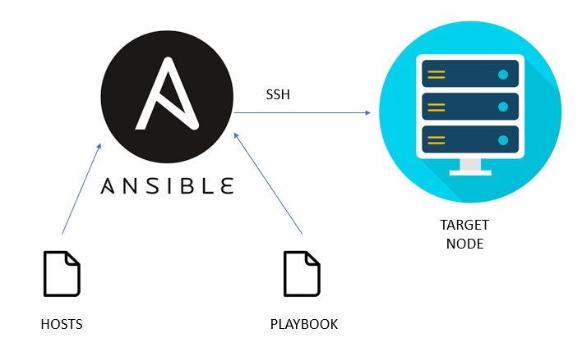
What is Ansible?

Slide 3
Table of content
What is Ansible?
How does ansible work?
What is Ansible Inventory?
Ansible Ad-hoc Commands
Ansible Configuration files
Writing and running an Ansible playbook

Slide 4



1.
What is Ansible?

Slide 5
What is Ansible?
Ansible is an automation tool that can be used to:
Automate configuration management tasks to maintain consistency across systems,
Provision and manage infrastructure resources in a scalable and efficient manner,
Deploy cloud infrastructure or on premises servers,
Orchestrate processes across multiple servers and devices, etc
Ansible uses SSH to connect to devices or servers
It is written in Python language
It is owned by Red Hat (Red Hat Ansible Automation Platform)

Slide 6
What is Ansible?
Ansible is agentless: it doesn’t require any additional software or agents to be installed on the target systems.
This is different from tools like Puppet or Chef, that need an agent on the servers they are accessing
Ansible is push-based: so from the Ansible master, you push your changes to the target servers
Ansible uses a declarative language called YAML (Yet Another Markup Language) to define playbooks (desired state of the system).
Ansible integrates with various systems and services, including cloud platforms, network devices, databases, and more.
The learning curve of Ansible is very easy (very detailed documentation)
Here is the link to the Ansible latest Documentation ansible Docs

Slide 7
2.
How does Ansible work?

Slide 8
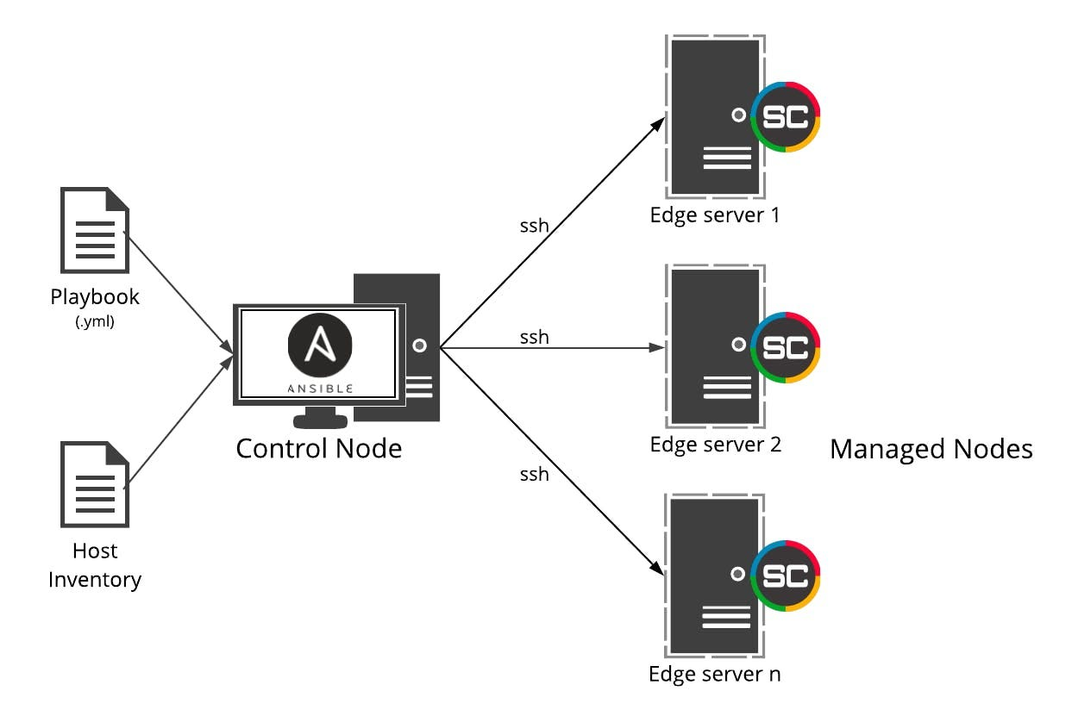

Slide 9
How does Ansible work ?
Ansible begins by creating an inventory, a list of hosts or devices it will handle. The inventory can be a static file or generated dynamically with scripts or plugins.
Ansible uses the concepts of control and managed nodes. It connects from the control node, any machine with Ansible installed, to the managed nodes sending commands and instructions to them.
The units of code that Ansible executes on the managed nodes are called modules.
Each module is invoked by a task, and an ordered list of tasks together forms a playbook.
Users write playbooks with tasks and modules to define the desired state of the system.

Slide 10
How does Ansible work ?
Ansible sequentially executes tasks defined in the playbooks on the target hosts. It manages the execution and collects the results of each task.
Ansible generates detailed reports on the status and outcome of each task, indicating whether it succeeded or failed
Ansible can perform tasks on multiple hosts simultaneously, ensuring efficient and scalable automation.
Ansible provides options to extend functionality through custom modules, plugins, and dynamic inventory scripts, enabling integration with diverse systems, services, and APIs.

Slide 11
Follow the link below this slide in the lesson materials to get more information about Ansible concepts
To install Ansible on any operating system, you can check the official documentation here

Slide 12
3.
What is Ansible Inventory?

Slide 13
What is Ansible Inventory?
Ansible inventory is a file or a collection of files that lists the hosts or devices managed by Ansible.
It includes a list of hostnames or IP addresses of the target systems that Ansible will interact with.
Inventory allows hosts to be grouped logically based on attributes or roles, making it easier to target specific subsets of systems.
Inventory can be static (manually defined) or dynamic (generated automatically) using scripts or plugins.
Inventory allows you to assign variables to hosts or groups, allowing you to customize and fine-tune configurations as needed.
Ansible supports various inventory sources such as: YAML file, dynamic inventory scripts, cloud platforms, and external systems like AWS EC2 inventory.

Slide 14
Follow the link below this slide in the lesson materials to get more information about Ansible Inventory.

Slide 15
4.
Ansible Ad-hoc Commands

Slide 16
Ansible Ad-hoc Commands
Ad-hoc commands are executed from the command line in real-time, providing immediate results without the need for playbook creation or execution.
Ad-hoc commands are designed to perform a single task or action on the target hosts.
Syntax of Ad-hoc Commands:
ansible [hostgroup] module/options[arguments]
Ad-hoc commands are best suited for simple tasks and quick fixes. For more complex automation, it is recommended to use Ansible playbooks.
Ad-hoc commands use Ansible modules for specific tasks on target hosts, offering predefined functions like installing packages, copying files, managing services, and more.

Slide 17
Follow the link below this slide in the lesson materials to practice some Ansible Ad-hoc commands

Slide 18
5.
Ansible Configuration files

Slide 19
Ansible Configuration files
The Ansible configuration file is a text file that defines various settings and options for Ansible's behavior and execution.
The default Ansible configuration file is located at /etc/ansible/ansible.cfg
The configuration file supports comments (lines starting with "#" symbol) to add explanatory notes or disable certain settings.
Ansible allows multiple configuration files, reducing the need for constant changes based on the environment.
The configuration file enables users to customize and optimize Ansible by overriding default settings, fine-tuning its behavior to meet their specific requirements.

Slide 20
To manage Ansible Configuration files, click on the link below this slide in the lesson materials to access the documentation.

Slide 21
5.
Writing and running an Ansible playbook

Slide 22
Write and run an Ansible playbook
To write and run an Ansible playbook, follow the steps below:
Create a Playbook: Begin by creating a YAML file that outlines the playbook's structure
Define Hosts: Define the target hosts or groups in the playbook where tasks will be executed.
Define Tasks: Specify the tasks to be performed on the target hosts, using Ansible modules.
Configure Task Parameters: Set parameters for each task, such as options, variables, and conditions.
Run the Playbook: Execute the playbook using the ansible-playbook command.
Review Results: Analyze the output to ensure the successful execution of tasks and gather detailed reports.

Slide 23
Follow the link below this slide in the lesson materials to write and run a sample Ansible playbook.

Slide 24

Thanks!
Any questions?
You can find us at:
website: https://utrains.org/
Phone: +1 (302) 689 3440
Email: contact@utrains.org

Slide 25
Click on the link below to contact the support team for any issue!
https://utrains.org/support/
Create a ticket for your problem and we will get back to you soon!

